Slide 1

Streaming Data Analytics Pipeline for IoT Sensor Data
Ravali
Shreeja
Parisha

Slide 2

Business Logic:
Client: A Manufacturing Company
Problem statement:
The IoT devices continuously generate sensor data, which needs to be processed and analyzed in near real-time to monitor device performance, and make data-driven decisions.
Challenges:
The challenge is to design and implement an automated pipeline that can ingest, process, store, and monitor this streaming data efficiently using AWS services, ensuring scalability and reliability.

Slide 3






Overview and Technology Stack
Objective: Build a scalable, real-time streaming data analytics pipeline for IOT sensor data.
Services used:
Python
Spark
EMR
S3
CloudWatch
IAM

Slide 4
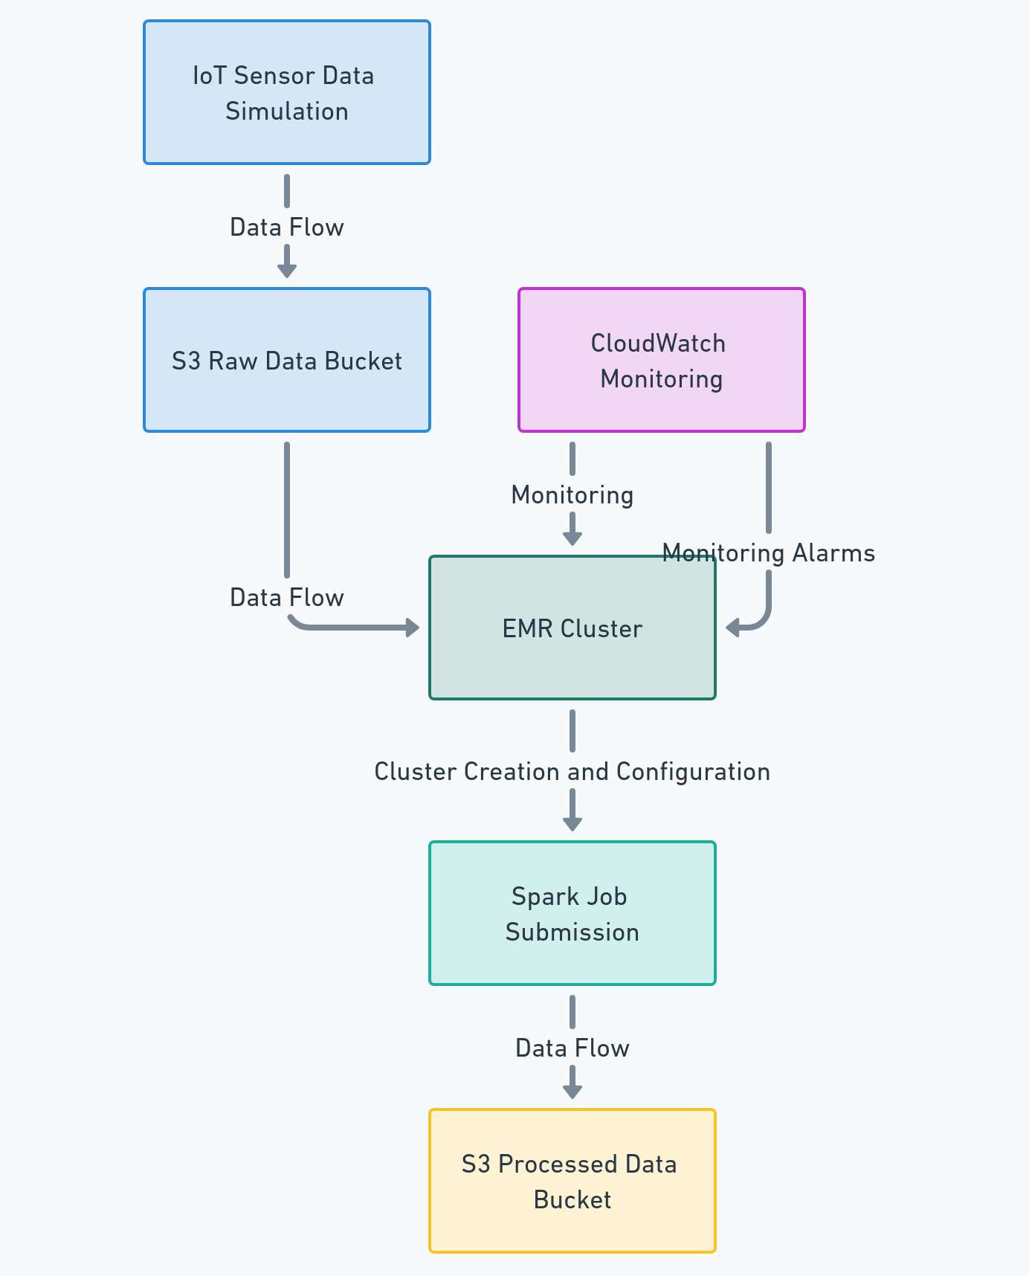
End-to-End Process Flow
Data Ingestion: Simulate IoT sensor data.
Data Upload: Send data to S3.
Data Processing: Use Spark on EMR.
Data Storage: Store processed data in S3.
Monitoring: Monitor using CloudWatch.

Slide 5
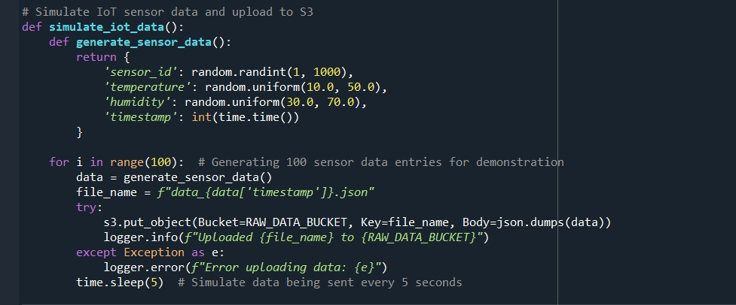
Simulated IoT Sensor Data
Description:
The dataset includes readings like temperature and humidity.
Each data entry is tagged with timestamp and sensor ID.
Data Format:
Typically structured in JSON format, containing fields such as timestamp, sensor ID, and the sensor readings.

Slide 6
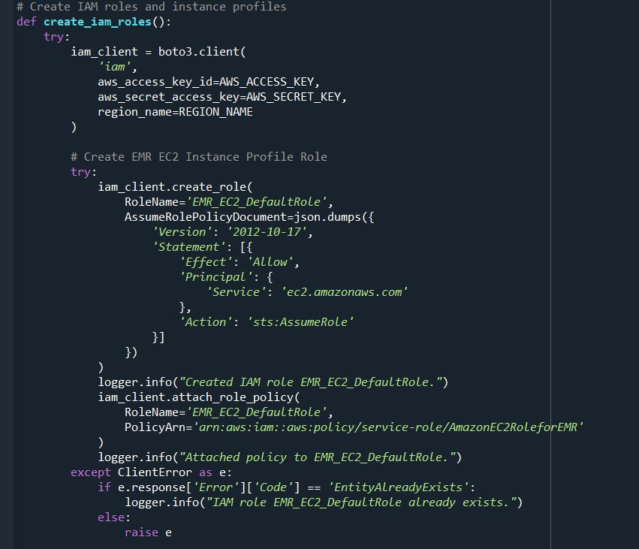
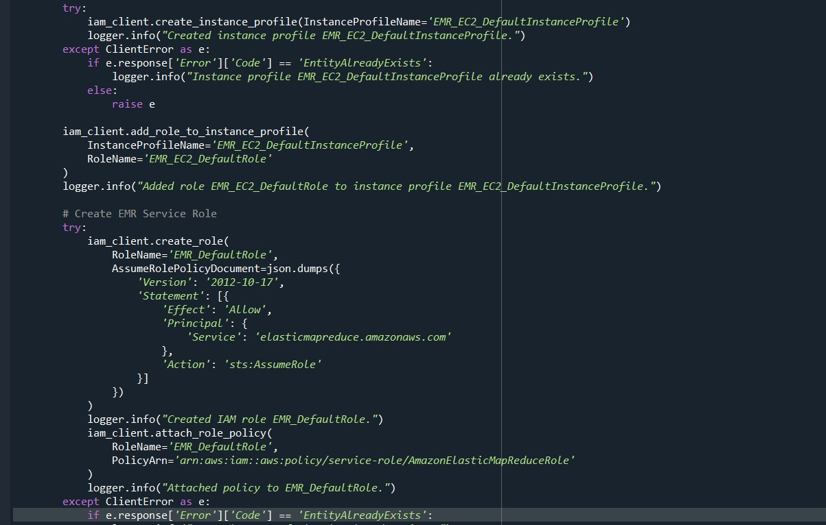
IAM Roles and Permissions
EMR_EC2_DefaultRole: Allows EC2 instances in the EMR cluster to interact with other AWS services like S3.
EMR_DefaultRole: Enables the EMR service to access S3 buckets and other AWS resources.

Slide 7
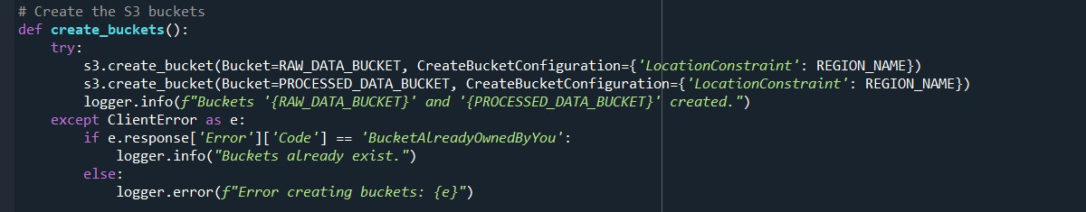
Setting Up S3 Buckets
Purpose:
Raw data bucket: Stores the ingested IoT sensor data.
Processed data bucket: Stores the processed output data.

Slide 8
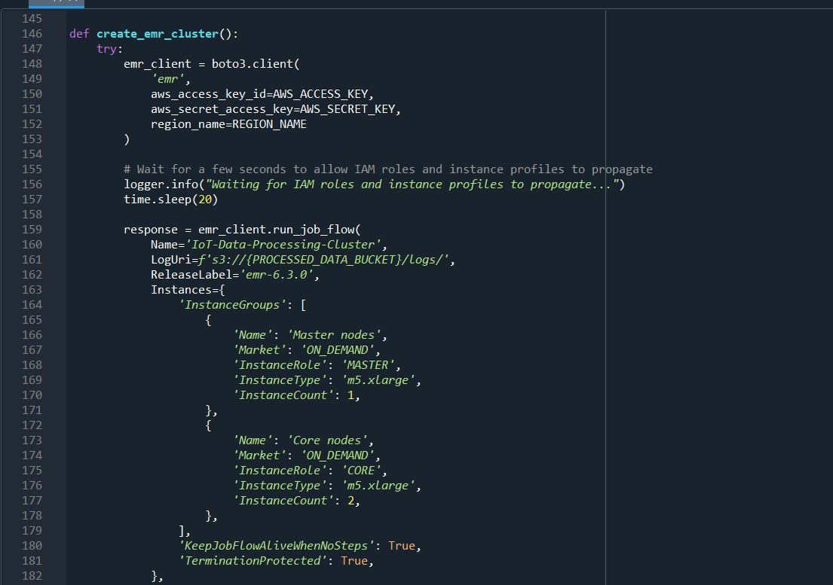
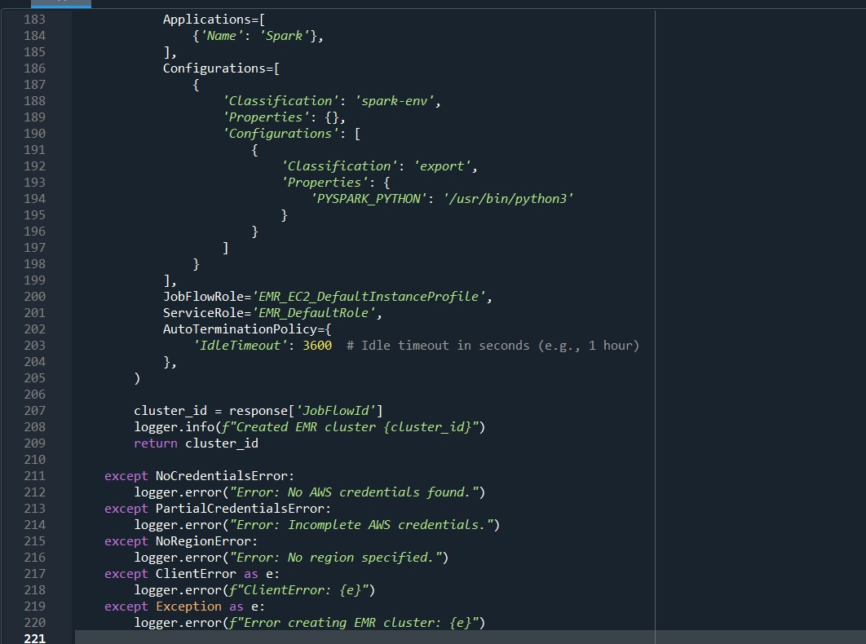
Setting Up EMR Cluster
Purpose:
Configuring an EMR cluster to run Spark jobs.
Cluster Configuration:
Typically involves choosing instance types, setting up the number of instances, and defining roles.

Slide 9
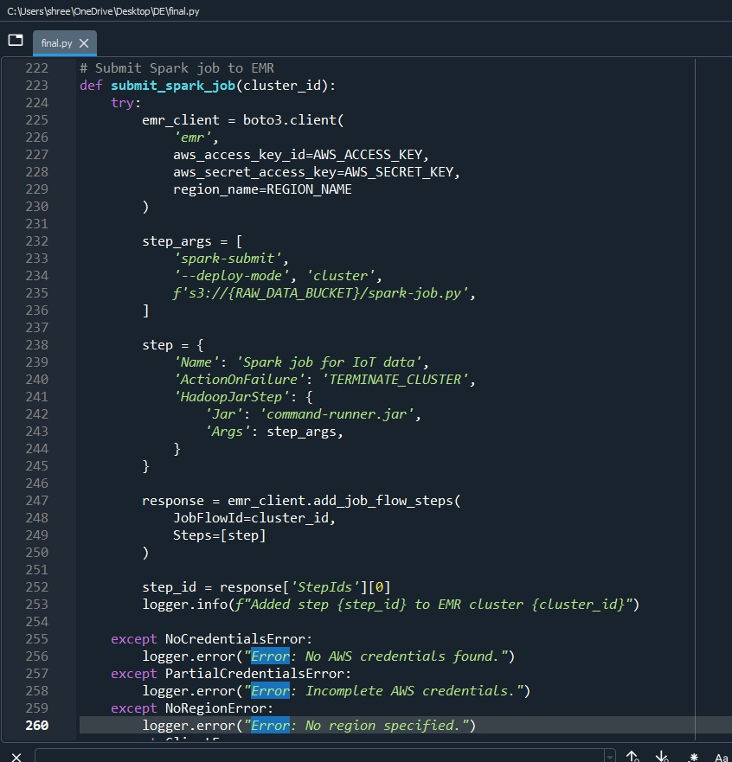
EMR Job Flow
Job Submission:
Submits a Spark job to an EMR cluster. The job processes IoT sensor data stored in an S3 bucket. The script is executed in cluster mode, ensuring that the processing occurs on the EMR cluster.
Spark Job Script:
Reads data from an S3 bucket, performs data transformations, and writes the results back to S3. It filters data based on temperature, converts timestamps, and aggregates data by sensor ID.

Slide 10
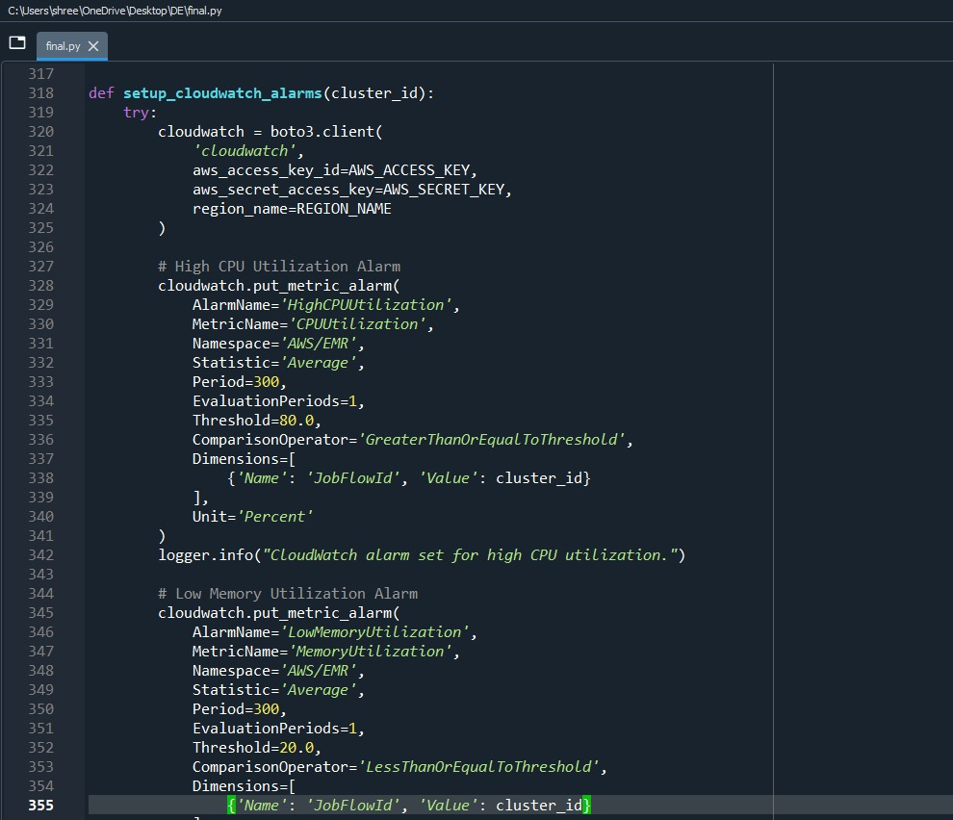
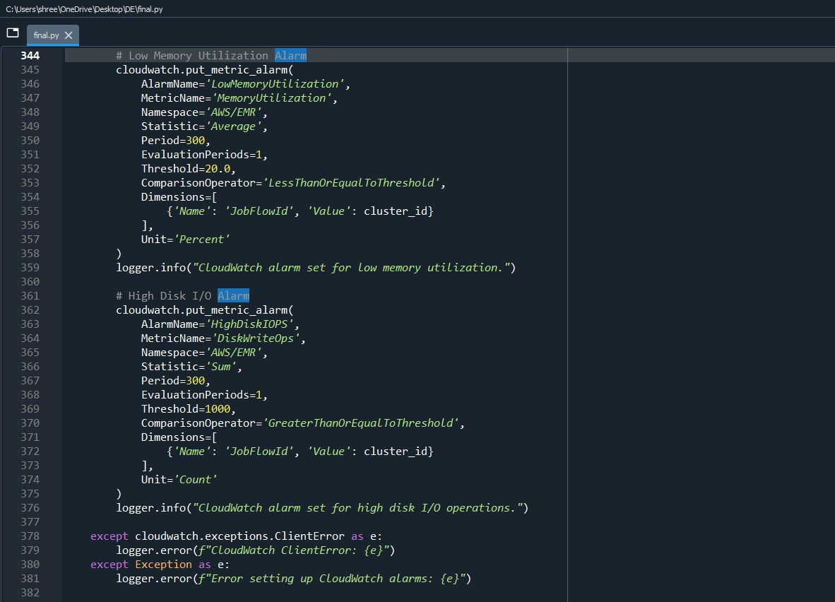
Monitoring with CloudWatch

Slide 11
Thank you

